Slide 1

NGO-ISAC
Cloud Services Mapping
https://www.ngoisac.org/ membership@ngoisac.org

Slide 2
Cloud Services Mapping
Mapping the org's cloud service providers.
gain visibility to cloud-based services
Infrastructure-as-a-Service (IaaS),
Platform-as-a-Service (PaaS),
Software-as-a-Service (SaaS).
Limit risk of uncontrolled, unconfigures cloud services.

Slide 3
Related Missions
Mission 2: ID of Critical Functions-The purpose of this mission is to support the Beneficiary in identifying critical functions essential for service delivery within their NGO. The Builders assist by evaluating the organization's operations, systems, and processes to determine the key functions that require special attention from a cybersecurity perspective. This helps prioritize resources and focus on protecting the most crucial aspects of the NGO's services
Mission 3: Assets Inventory Development- The purpose of this mission is to assist the Beneficiary NGO in developing an inventory of their assets. This includes identifying and documenting all the hardware, software, and digital resources used within the organization. Having a comprehensive inventory helps in understanding the organization's technology landscape, identifying potential vulnerabilities, and implementing appropriate security measures. The support and advice provided by the Builder focuses on equipping the NGO with a structured process for asset inventory management.

Slide 4
Definitions
Service – A software product that performs a function for your organization. ( eg., Mail or CRM )
Hosted – Outsourced management vs. “self-hosted”
Users or Principals– accounts that grant access and permission to services for individuals or tools
Managed Service – A Hosted service where basic upkeep is handled by Hosting provider
Saas, XaaS – “something”-as-a-Service. Managed Services.
Platform – Tool suites and services that don’t deliver direct business value but instead are used by systems that do
Notes:
There are a lot of words… and they keep making up new ones https://www.auvik.com/franklyit/blog/aas-as-a-service-list/

Slide 5

Cloud Service Mapping
Cloud Services offer many services.
More than you actually use.
What specific services tools you are using?
Part of Asset Management
Configuration Management
Tailored to the specific needs of your providers
AWS - Amazon
GCP - Google
Azure - Microsoft

Slide 6
Cloud Service Mapping
Enumerate Services being used
Your organization may only use a small handful of them.
The secret is that the cloud is made up of servers.
It’s just computers
Some service offerings are more foundationation than others
DNS
Mail
CRM
Next slide circle the logos of the service offerings you are using

Slide 7
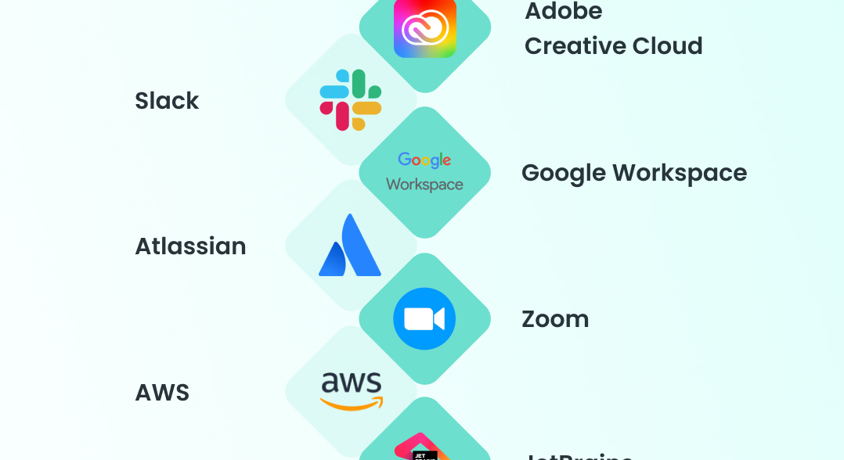
List of Popular Cloud Services

Slide 8
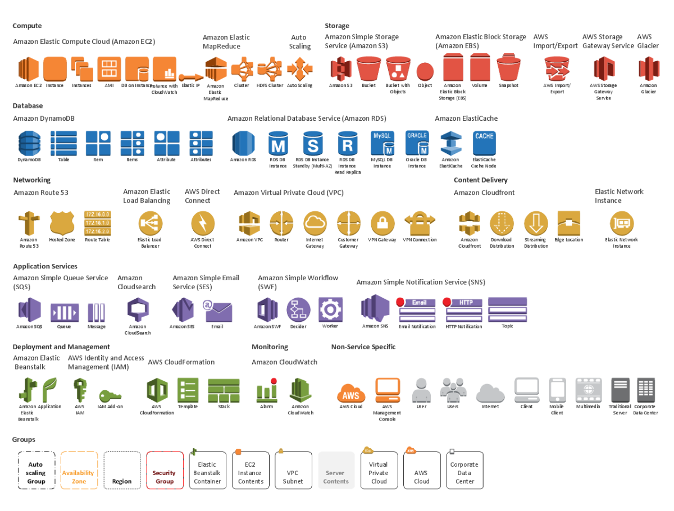
many
So many things

Slide 9
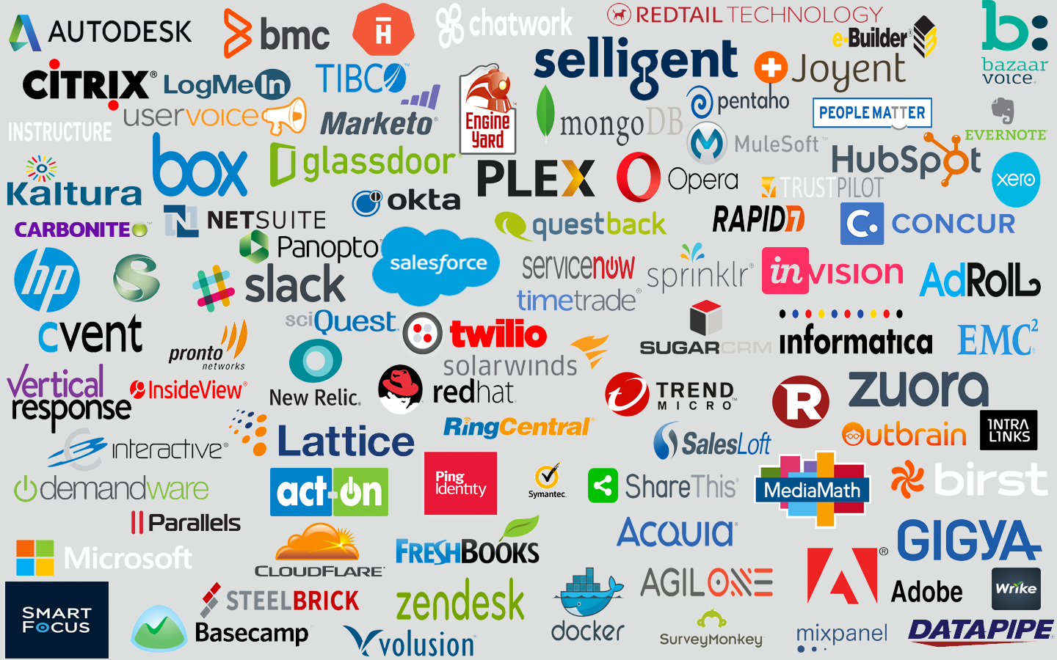
many

Slide 10
Cloud Service Mapping
plan service lifespan
evaluate new service offerings.
Multi-cloud offerings are expensive
interoperability
silos are liabilities
What cost
setup 0.$
operation $$
migration ( priceless)
Some service offerings are dependent

Slide 11
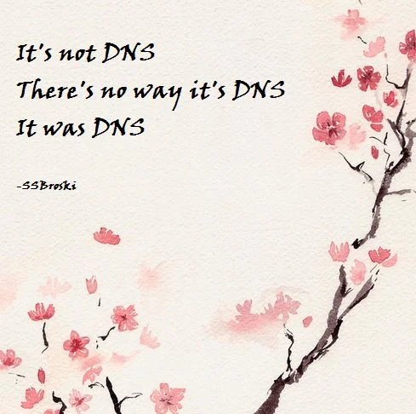
Cloud Services Security Must Do’s (step -1)
Secure DNS Roots
Providers
Tucows
Rt53
Cloudflare
Details
SOA records
Servers
MX for mail
SPF
DKIM

Slide 12
Cloud Services Security Must Do’s (step 0)
Identify Cloud Services
invoices
personnel for out-of-pocket services
shadow IT too
Map which products are deployed
Use the admin billing page
watch free tiers too
justify each spend

Slide 13
Cloud Services Security Must Do’s (step 0.5)
Identity management (IAM)
Goto IAM (identity access management) dashboard and
verify Users and Principals
SSO (single sign on): prevent silos
Part of offboarding policy
Audit Networking connections
Justify every endpoint
VPN/VPC Virtual private X
minimize ACL ( access control list )
for every service

Slide 14
Cloud Services Security Must Do’s (step 1)
Secure Root account
use highest level of security available
two-factor authentication via FIDO tokens
passkey
second factor authentication
Create users and automations with proper Role Based Access Controls (RBAC)
Accounts and services should have narrowly scoped access controls by default
Do not use or rely on “default” admin roles.
delete them

Slide 15
Cloud Services Security Must Do’s (step 1)
Backups
snapshots
Restore point objective
restore fire drills
the Cloud is not enough
human error
network outage
bucket protection (S3 etal)

Slide 16
Cloud Services Security Must Do’s (step 2)
Create alerts for high value security events
Sharing of cloud resources with outside accounts
Creation of API keys
Creation of new users
Offerings
Cloudwatch ( Amazon )
Splunk (Cisco) $$$
Google Admin
GAT+ $
Dark web monitoring
Create enough alerts to be sensitive
but not too many ( signal/noise ratio )

Slide 17
Cloud Services Security Must Do’s (step 2)
Plan for Incident Response
What Happens on a bad day
Disaster recovery
Lawer
GC or insurance provided
Breach vs. incident
Communication plan
out of band (signal, FB messenger, carrier pigeon)
users, downstream

Slide 18
[ Questions ? ]
Notes:
Be ready for: Constellation, Membership dues

Slide 19
Notes:
Be ready for: Constellation, Membership dues

